Slide 1
Ecommerce Product Categorization
By
Revanth Kumar Santi

Slide 2
Train Dataset
Columns
'uniq_id', 'crawl_timestamp', 'product_url', 'product_name','product_category_tree', 'pid', 'retail_price', 'discounted_price','image', 'is_FK_Advantage_product', 'description', 'product_rating','overall_rating', 'brand', 'product_specifications’.
Shape of dataset: (14999, 15)

Slide 3
Overview
Very little percentage of missing values
Replaced with mode and mean
Imbalance data
Treated with SMOTE oversampling

Slide 4
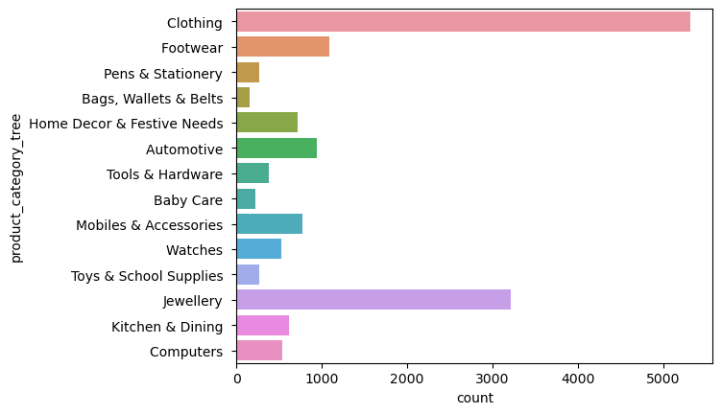
product_category_tree

Slide 5
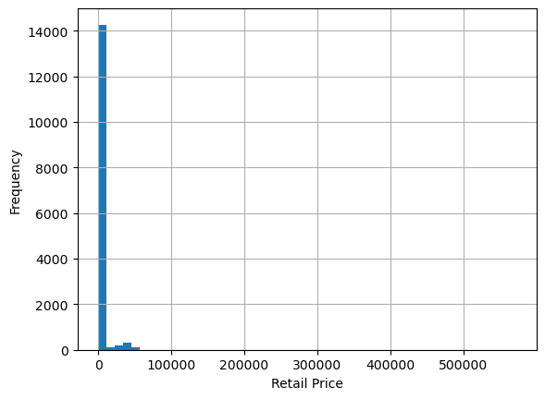
Retail Price

Slide 6
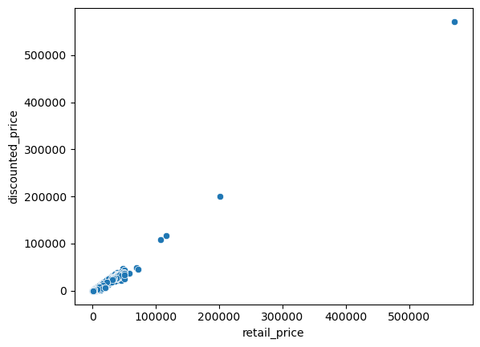
retail_price Vs discounted_price

Slide 7
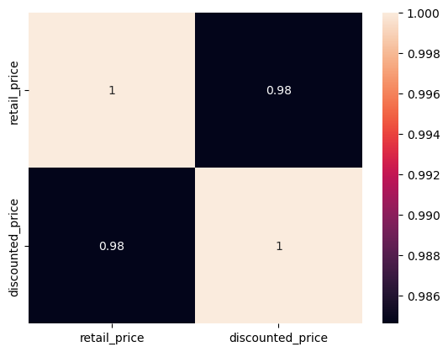
retail_price Vs discounted_price

Slide 8
Feature Engineering
We also performed feature engineering for numerical and categorical columns seperatly.
Numerical-TF-IDF
Categerical-LabelEncoder

Slide 9
Model Selection
80:20 split
Logistic Regression
Random Classifier
XGBoost
XGBoost and Logistic Regression model showed best accuracy
Out of them Xgboost showed little more better.
By applying XGBOOST model for testing we got nearly 97% accuracy

Slide 10
Thank You

